Slide 1

Enhancing Crime Prediction with 2D-CNN Frameworks
A review of major project submitted to
Ms Sara Fatima
Asst. Professor, DEPARTMENT OF IT
In partial fulfillment of the requirement for the award of a degree of
BACHELOR OF TECHNOLOGY
In
INFORMATION TECHNOLOGY
By
Afeefa Shadaan 20L51A1201
Raveena Ratan 20L51A1225
Simran Mathur 20L51A1234
Department of Information Technology
Shadan Women’s College Of Engineering And Technology, Khairtabad.
Hyderabad-500 004
2023-2024

Slide 2
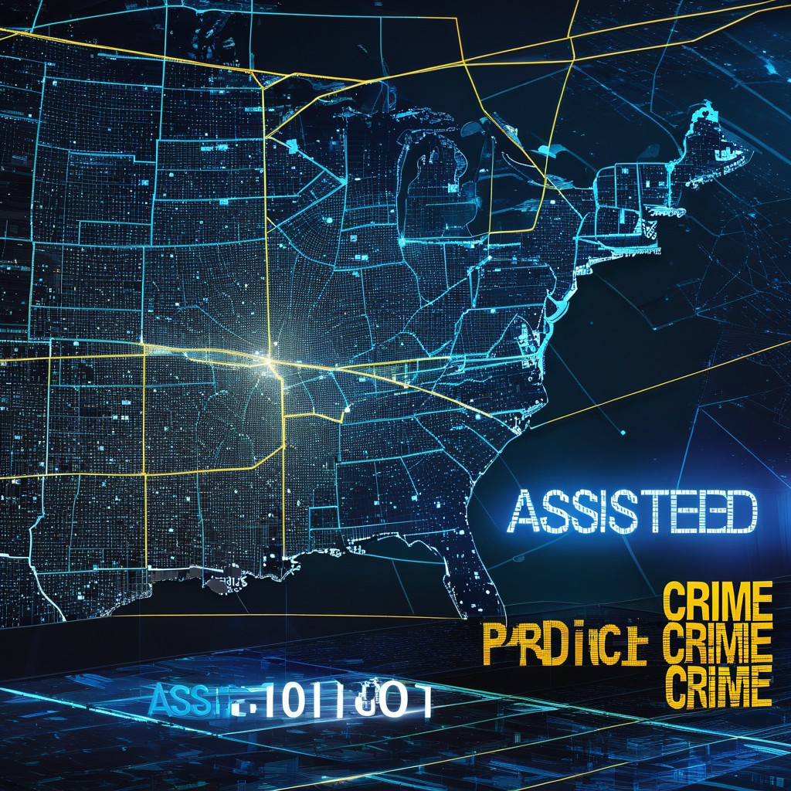

Enhancing Crime Prediction with 2D-CNN Frameworks

Slide 3

CONTENT
Abstract
Introduction
Literature
Description
Parameters
Existing system
Proposed system
Pro’s & con’s
Conclusion

Slide 4

Abstract
As global population grows, challenges in public safety regulation have emerged.
A recent study proposes a method for predicting crime frequency by using demographic data and historical events. The study suggests a framework for predicting and assessing crimes for machine learning algorithms.
Machine learning approaches, including Decision Trees, Neural Networks, K-Nearest Neighbors, and Impact Learning, are compared for their performance in predicting future events.
The Decision Tree algorithm has a maximum accuracy of 81% in predicting crimes.
These results show that applying Machine Learning techniques can help predict criminal activities, contributing to improved public safety.

Slide 5

Introduction
Public safety is a major concern for the global population due to rapid urbanization and an increase in terrorist attacks.
The Global Terrorism Database, which defines terrorist attacks as ”acts of violence by non-state actors perpetrated against civilian populations, intended to cause fear, in order to achieve a political objective,” the number of terrorist attacks in the last decade was the highest ever recorded.
Our aim is a crime prediction. We have incidents to inform residents and municipal officials about the most dangerous places, therefore providing value to the community and increasing public safety. In this regard, this sort of prediction can be beneficial in a variety of ways, including more efficient and effective patrol route planning, as well as for tourists who are ignorant of the city’s most hazardous locations.
Machine learning (ML) techniques can help reduce crime by addressing issues related to urban development and data extraction.
Machine learning algorithms can predict the likelihood of crimes occurring in specific areas and at certain times by analyzing historical crime data. This helps law enforcement allocate resources effectively and prevent crime. However, ethical considerations must be taken to avoid bias and discrimination.

Slide 6

EXISTING SYSTEM
The benchmarked systems in question employed diverse audio representations, encompassing Mel-Frequency Cepstral Coefficients (MFCC), Constant Q Transform (CQT), and Fast Fourier Transform (FFT). These representations were processed through simple linear models, specifically Softmax Regression, for genre classification. Additionally, multilayer perceptron (MLP) models were employed with MFCC, CQT, and FFT features as inputs. Notably, the existing systems refrained from incorporating convolutional neural networks or other deep learning methodologies. Instead, the emphasis was on utilizing hand-engineered input features, eschewing learned representations. The comparison among these systems highlighted a reliance on traditional signal processing techniques and relatively straightforward models, underscoring a departure from more complex neural network architectures. This succinctly captures the essence of the evaluated approaches and their shared characteristics, offering a comprehensive overview of the key methodologies and limitations inherent in the existing systems.

Slide 7
PROPOSED SYSTEM
• Motivation:
Use audio features instead of hand-crafted MFCCs for genre classification.
• Approach:
Use a 2D convolutional neural network on spectrograms to learn timbral and temporal patterns.
• Input:
30-second audio clips converted to spectrograms using Short-time Fast Fourier Transform (STFT).
4 filters detected percussion, harmony, pitch slides. Filters convolved with spectrogram for 4 feature maps.
• Subsampling:
Applied 2x2 max pooling on feature maps for dimensionality reduction and translation invariance.
• Conclusion:
2D CNNs' learned features from spectrograms are more effective for genre classification than engineered MFCC features. End-to-end feature learning is promising over pipeline systems.
In summary, the key ideas are -2D CNN on spectrograms for feature learning, end-to-end training, and outperforming traditional methods for music classification.

Slide 8



Literature :
Title | Author | Year | Method | Parameters
Edge Assisted Crime Prediction and Evaluation Framework for Machine Learning Algorithms | Apurba Adhikar, Saydul Akbar Murad, Choong Seon Hong, Md. Shirajum Munir | 2022 | Decision Trees, Neural Networks,K-Nearest Neighbors,Impact Learning. | real-time data input, edge computing capabilities, algorithmic models, crime features (type, location, time), and evaluation metrics.
An Application for Risk of Crime Prediction Using Machine Learning | Luis Fonseca, Filipe Cabral Pinto, Susana Sargento. | 2021 | Linear Regression, Additive Regression, Decision Stump and Support Vector Machines (SVM) | Crime types, geographical locations, time factors, socio-economic indicators, and historical data
Crime Analysis Through Machine Learning | Suhong Kim, Param Joshi, Parminder Singh Kalsi; Pooya Taheri | 2019 | Machine-Learning predictive models, K-nearest-neighbour and boosted decision tree, | crime types, geographic locations, time periods, and socio-economic factors.
Crime Prediction Using Decision Tree (J48) Classification Algorithm | Emmanuel Ahishakiye, Danison Taremwa, Elisha Opiyo | 2017 | Decision Tree classifier (J48),Multilayer Perceptron(MLP),Naive Bayes Classifier Support Vector Machines (SVM) | Dataset features (crime types, locations, timestamps), model training criteria, decision tree depth, and splitting criteria. Evaluation metrics, such as accuracy and precision,
Using Machine Learning Algorithms to Analyze Crime Data | Lawrence McClendon,Natarajan Meghanathan | 2015 | Decision Trees, Support Vector Machines, K-Means, DBSCAN, Random Forest | Evaluating performance metrics, input features (crime types, locations, timestamps), model training duration,

Slide 9
Comparison of Existing and Proposed System
Aspect | Existing Approach | Proposed Approach
Input Representation | Relied on hand-crafted features like MFCC, CQT, and FFT | Leverages 2D visual representations (heat maps, choropleth maps) as input
Feature Extraction | Utilized traditional signal processing and manual feature engineering | Automatically learns relevant features from raw data using 2D-CNNs
Model Architecture | Employed simple linear models (Softmax Regression, MLP) | Utilizes powerful 2D Convolutional Neural Networks (2D-CNNs)
Temporal Modeling | Limited capability to capture temporal dependencies | Models spatiotemporal patterns by treating time as an additional dimension
Data Incorporation | Primarily focused on crime data from police reports | Integrates diverse data sources beyond crime data, such as demographic, socioeconomic, and social media data
Training Methodology | Separate stages for feature engineering and classification | End-to-end training of features and classifier via backpropagation
Translation Invariance | Susceptible to variations in input data | Learned filters can detect patterns regardless of location, enabling generalization
Multi-Modal Fusion | Restricted to a single data modality | Can fuse multiple modalities by stacking input channels

Slide 10
System Requirements:
HARDWARE REQUIREMENTS
Processor : Intel i3
RAM : 32 GB
Hard Disk Drive : Minimum 1 TB
Monitor : 27" Color Monitor
SOFTWARE REQUIREMENTS
Front End/GUI Tool : Microsoft Visual Studio 2018
Operating System : Windows 10 64-bit
Language : PYTHON
Application : Window Application
Back End : SQL SERVER 2005
FUNCTIONAL REQUIREMENTS
Data Collection
Data Analysis
Prediction Model:
Real-time Monitoring:
Reporting
NON FUNCTIONAL REQUIREMENTS
Performance Requirement
Software Quality Attribute
Maintainability
Usability
Security
Reliability
Scalability
Compliance

Slide 11

Concept Explanation
Problem Statement
The challenge is to develop an accurate crime prediction system using machine learning and diverse data sources to forecast crime hotspots and trends while overcoming the limitations of existing methods. This involves leveraging 2D convolutional neural networks (2D-CNNs) and diverse data sources to provide a more precise crime prediction method, ensuring reliability, efficiency, and maintainability.
System Architecture
To develop a crime prediction model, input data is collected from various sources and pre-processed. Feature engineering techniques are applied to extract relevant features, and the data is divided into training and testing datasets. The 2D Convolutional Neural Network (CNN) algorithm is then trained on the training data, with its parameters iteratively adjusted to minimize prediction errors. The testing data is utilized to evaluate the trained model's performance. The CNN architecture comprises several layers, including a conventional layer for initial feature extraction, a pooling layer for down sampling the feature maps, and dense (fully connected) layers that combine the learned features to generate the final prediction output. The objective is to develop an accurate and robust crime prediction system through the use of the 2D-CNN algorithm trained on the feature-engineered data

Slide 12
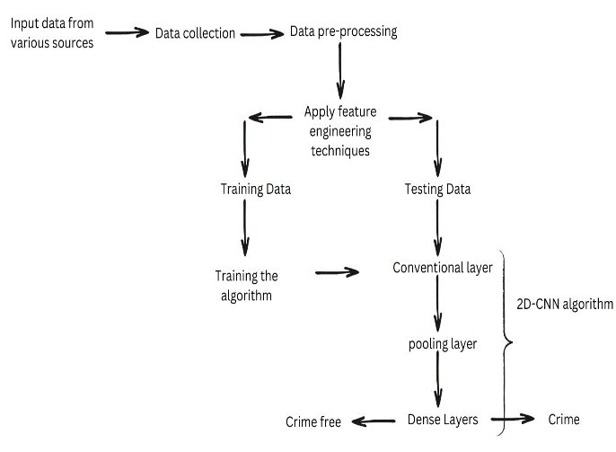
Figure :- System Architecture

Slide 13
Methodologies
The methodology involved data collection from diverse sources like crime reports, meteorological data, and demographics. Data preprocessing, normalization, and feature engineering were performed. 2D-CNNs were used, with data transformed into 2D images (heat maps, choropleth maps) to capture spatial-temporal patterns. Transfer learning refined the trained 2D-CNN for improved accuracy and prediction. Bias identification and mitigation ensured impartiality. Rigorous evaluation using standard metrics and cross-validation was conducted, with ethical considerations like plagiarism prevention and impartiality prioritized.
LIST OF MODULES:-
Data Collection: Gathering relevant data from various sources like databases, APIs, and manual curation for effective machine learning modeling.
Data Pre-Processing: Removing noise, selecting relevant features, and using techniques like support vector machines and random forests for data cleaning and fraud detection.
Feature Extraction: Utilizing 2D convolutional neural networks (CNNs) to automatically extract important spatial features and patterns from preprocessed data, particularly useful for crime data with geographical components.
Model Training: Splitting data into training and validation sets, training the 2D CNN model on the training set, and fine-tuning hyperparameters like learning rate, number of layers, and activation functions for optimal performance.
Model Evaluation: Assessing the trained model's accuracy and performance on validation data, and comparing it with other algorithms like random forests, support vector machines, and traditional neural networks.
Non-Crime Data Integration: Incorporating supplementary datasets like demographic, socioeconomic, or environmental data to enhance the model's predictive capabilities and accuracy.
Prediction and Analysis: Using the pre-trained CNN model for predictions on new data, evaluating outcomes, visualizing predictions and insights using tools like GIS or mapping software.

Slide 14
ALGORITHM USED IN THE PROJECT
2D CNNs are effective for extracting spatial features and patterns from crime data with geographical components. They consist of convolutional layers that learn hierarchical spatial features to model complex spatial dependencies and classify the future state of an area.
Key Contributions of 2D-CNN:
Efficient Feature Extraction: Automatically extracts features from input data, enabling the discovery of intricate patterns.
Convolutional Layers: Extract critical features by applying learned filters, and identifying high-level features from low-level input data.
Pooling Layer: Increases robustness and translation invariance of extracted features through subsampling operations like max or average pooling.
Robust Classification: Flattened feature maps undergo processing by a classification module (MLP or fully connected neural network) to learn correlations between extracted features and crime categories.
Softmax Activation: Generates probability distribution across classes, enabling predictions on the likelihood of criminal activities.
End-to-end Training: Trained end-to-end using backpropagation and optimization algorithms, allowing tailored feature representations and continuous refinement.

Slide 15
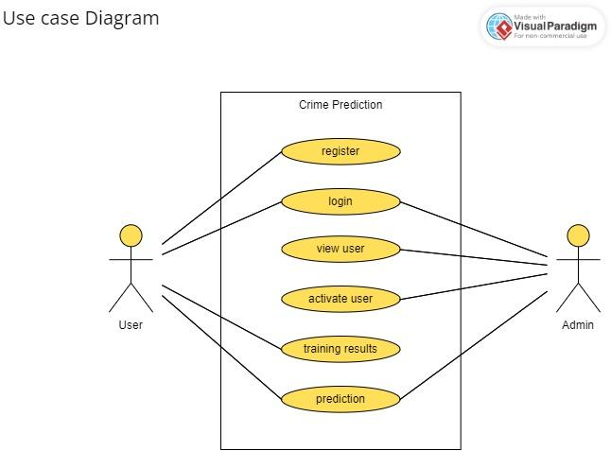
UML DIAgrams
Use case Diagram

Slide 16
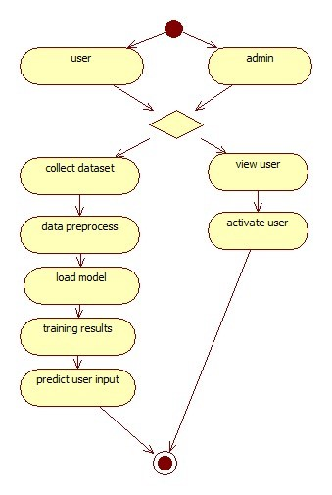
Activity Diagram

Slide 17
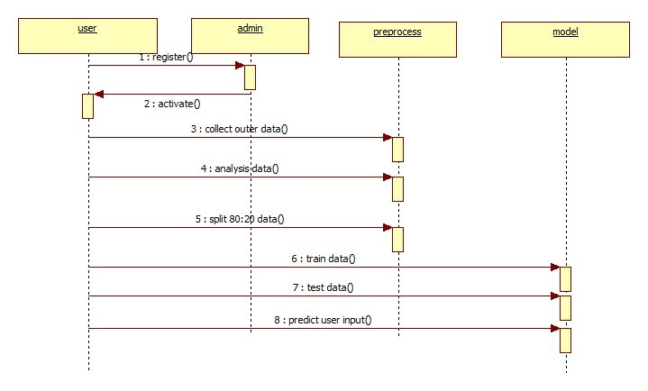
Sequence Diagram

Slide 18
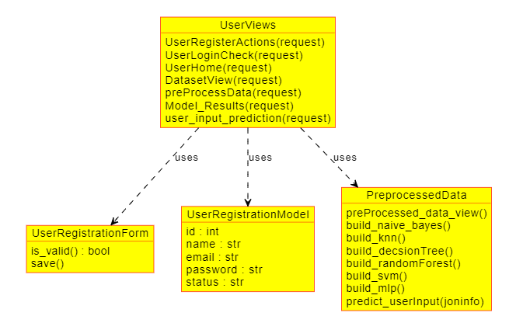
Object Diagram

Slide 19
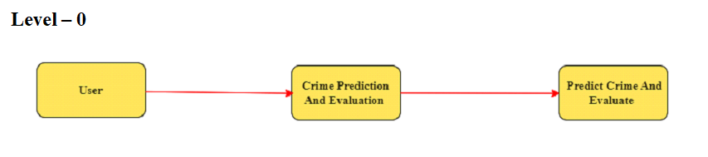
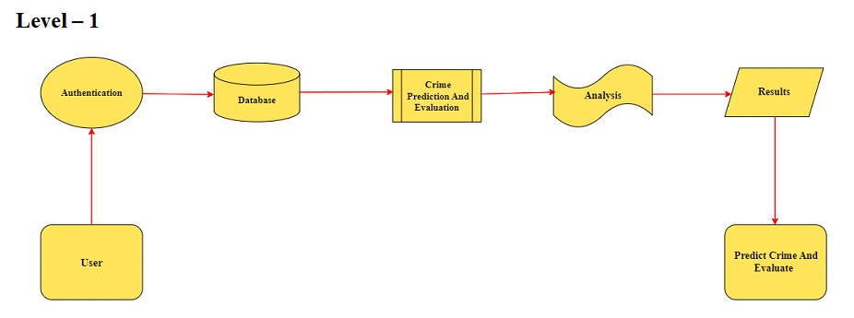
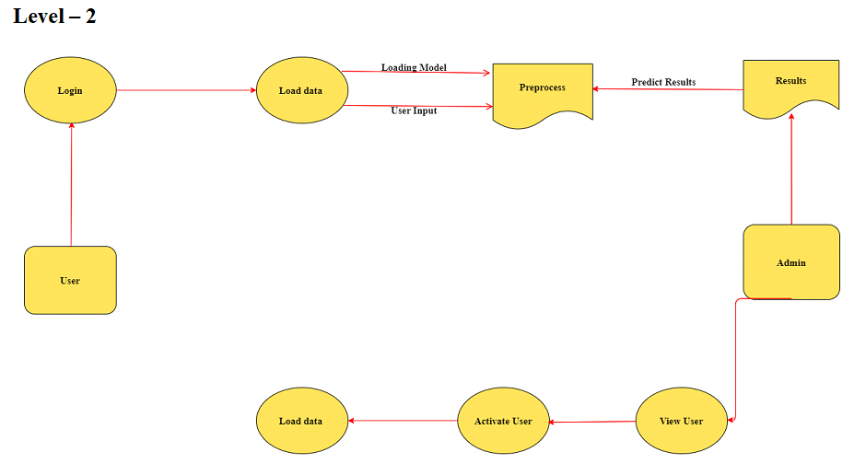
Data flow Diagrams

Slide 20
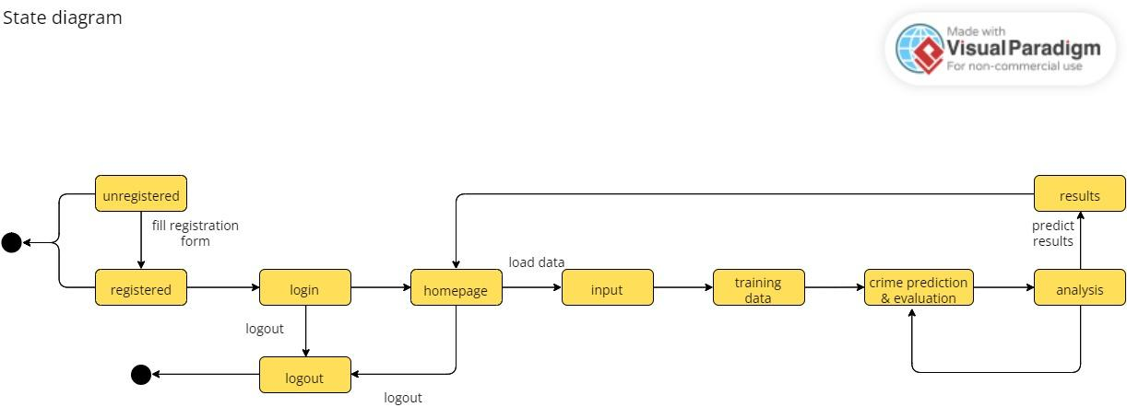
State Diagram

Slide 21
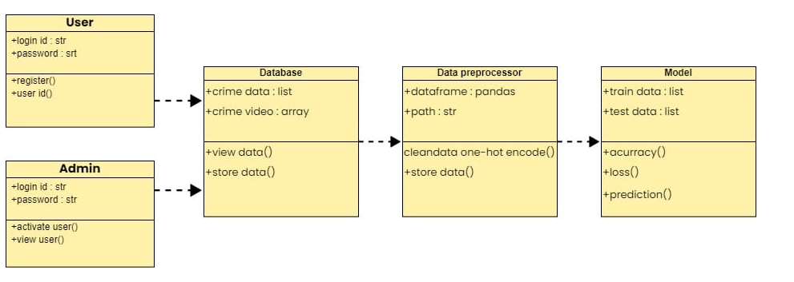
Class Diagram

Slide 22
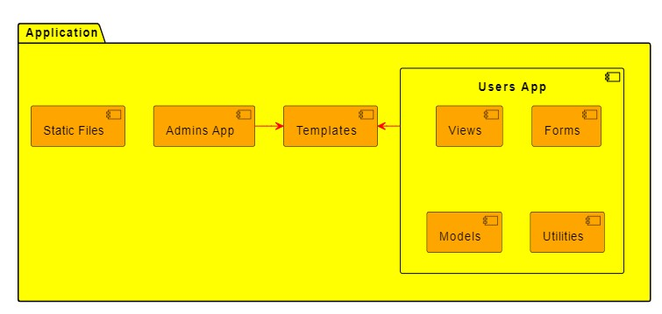
Component Diagram

Slide 23
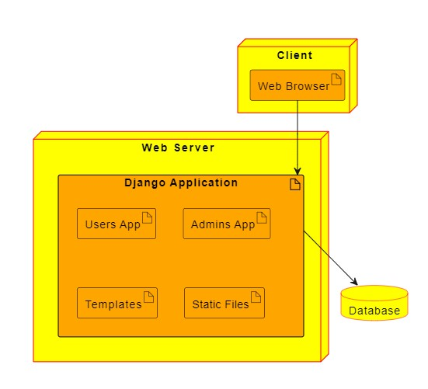
Deployment Diagram

Slide 24

Applications
Interoperability: Designed for seamless integration with existing systems and databases using standardized formats and interfaces, enabling data exchange and real-time updates.
Interaction: Provides user-friendly interfaces, interactive visualizations, and scenario analysis tools for data-driven decision-making.
Heterogeneity: Handles structured, unstructured, and semi-structured data from diverse sources, employing robust preprocessing and feature engineering techniques.
Scalability: Leverages distributed computing and parallel processing for handling increasing data volumes, with the ability to scale horizontally.
Performance Optimization: Utilizes distributed computing, caching strategies, and optimized machine learning algorithms for faster processing and predictions.
Security and Privacy: Implements access control, data encryption, and adheres to data protection regulations.
Maintainability and Extensibility: Modular architecture, well-documented code, and provision for integrating new data sources and algorithms.
Deployment and Monitoring: Supports various deployment environments, includes monitoring and logging mechanisms, and automated deployment pipelines.
Collaboration and Integration: Provides APIs and interfaces for seamless communication and integration with other systems.
Continuous Improvement: Mechanisms for user feedback, regular updates, and adoption of new technologies.

Slide 25
Future Enhancement
Data Consolidation: Integrating diverse data sources like social media, weather, traffic, and demographics for more comprehensive crime trend analysis and precise forecasting.
Real-Time Action: Leveraging edge computing for data processing and swift pattern detection, enabling prompt alerts and efficient intervention tactics.
Privacy-Preserving Techniques: Implementing methods like federated learning and homomorphic encryption to safeguard privacy while deriving valuable insights.
Multi-Modal Data Analysis: Incorporating images, videos, and audio data to gain additional context and uncover patterns not easily recognizable in other data sources.
Interpretable AI Models: Developing transparent AI models that explain their predictions, promoting trust and accountability in decision-making processes.
Adaptive Learning Algorithms: Implementing online learning or reinforcement learning algorithms to enable continuous improvement as new data becomes available and criminal patterns evolve.

Slide 26
Future Enhancement
Human-Centric Design: Collaborating with law enforcement personnel and stakeholders to ensure the framework aligns with their requirements and preferences.
Spatiotemporal Analysis: Applying spatiotemporal analysis methods to reveal previously undetected crime hotspots and pattern dynamics for efficient resource allocation.
Collaborative Edge Networks: Interconnecting edge devices to share insights and predictions across locations, combining processing power and accumulated knowledge for increased accuracy and efficiency.
Long-Term Impact Assessment: Assessing the framework's long-term impact and creating a continuous improvement approach for refinement.
Ethical Considerations: Addressing bias and fairness concerns, regularly conducting audits and implementing bias detection and mitigation techniques.
Scalability and Resource Efficiency: Optimizing the framework for scalability and resource efficiency through efficient algorithms, distributed computing, and optimized resource allocation.

Slide 27
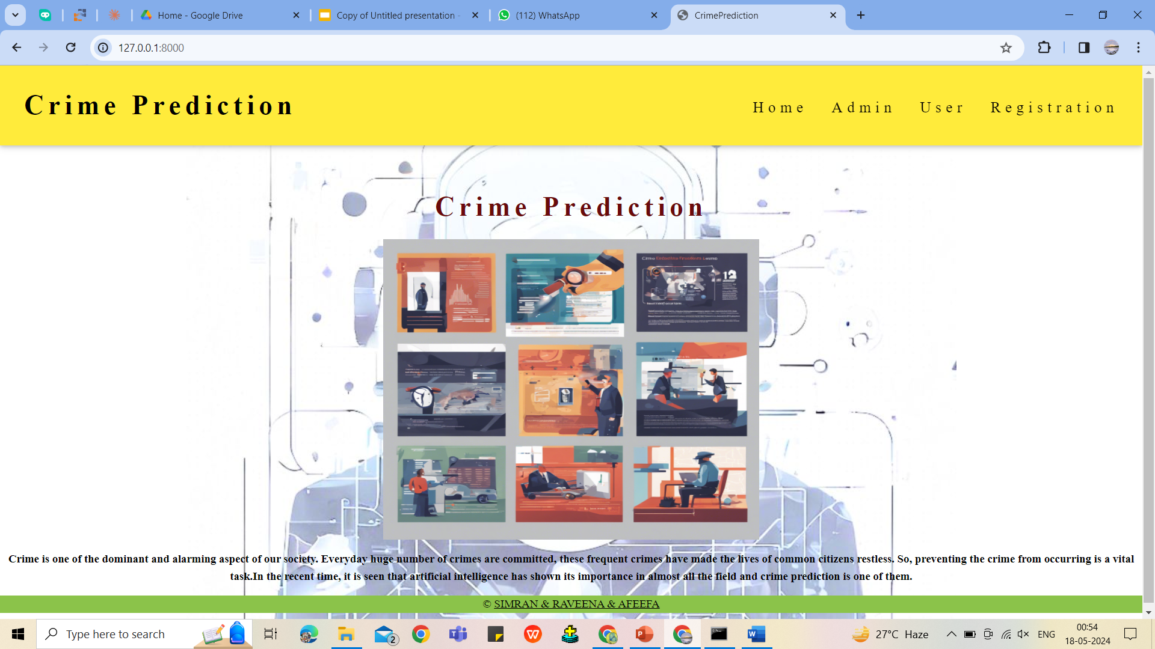
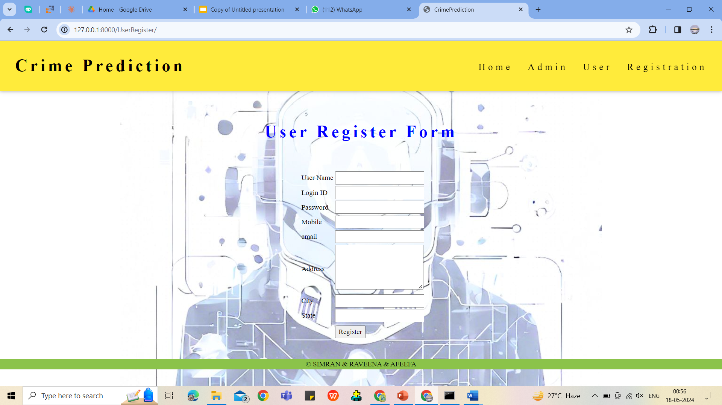
Screenshots
Home Page User Register Form
Figure:- 8.3.2.3 Admin Login Form

Slide 28
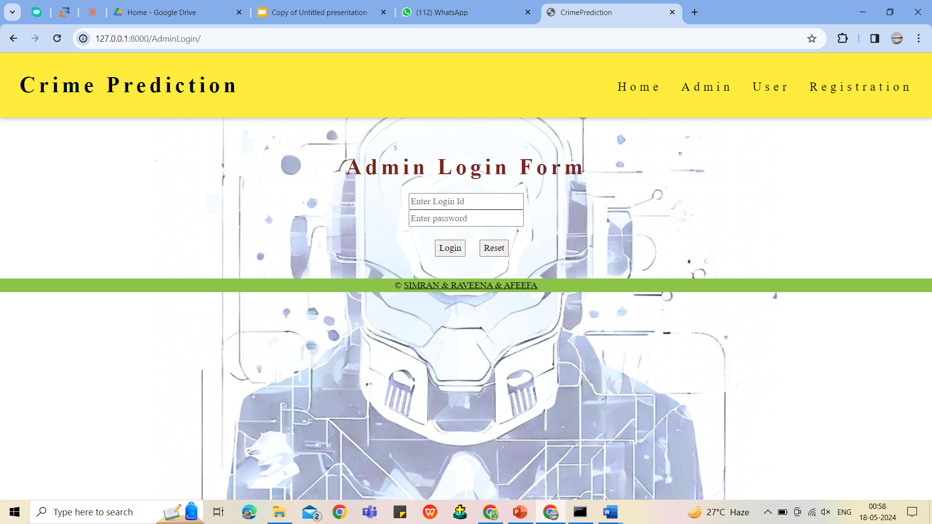
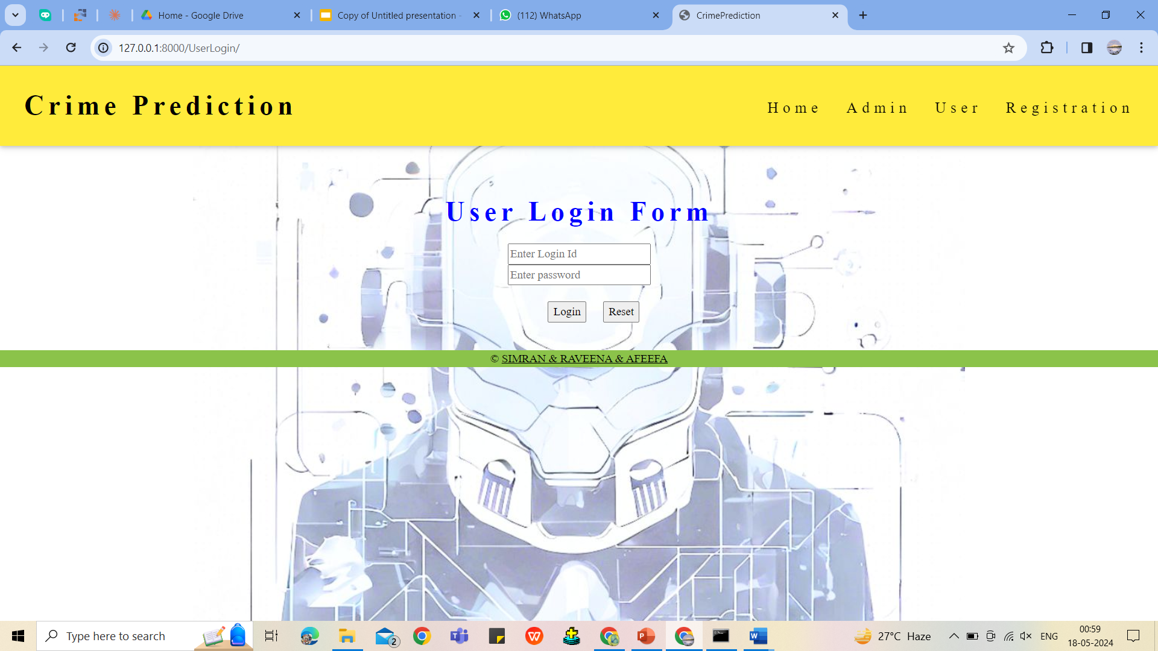
Screenshots
Admin Login Form User Login Form

Slide 29
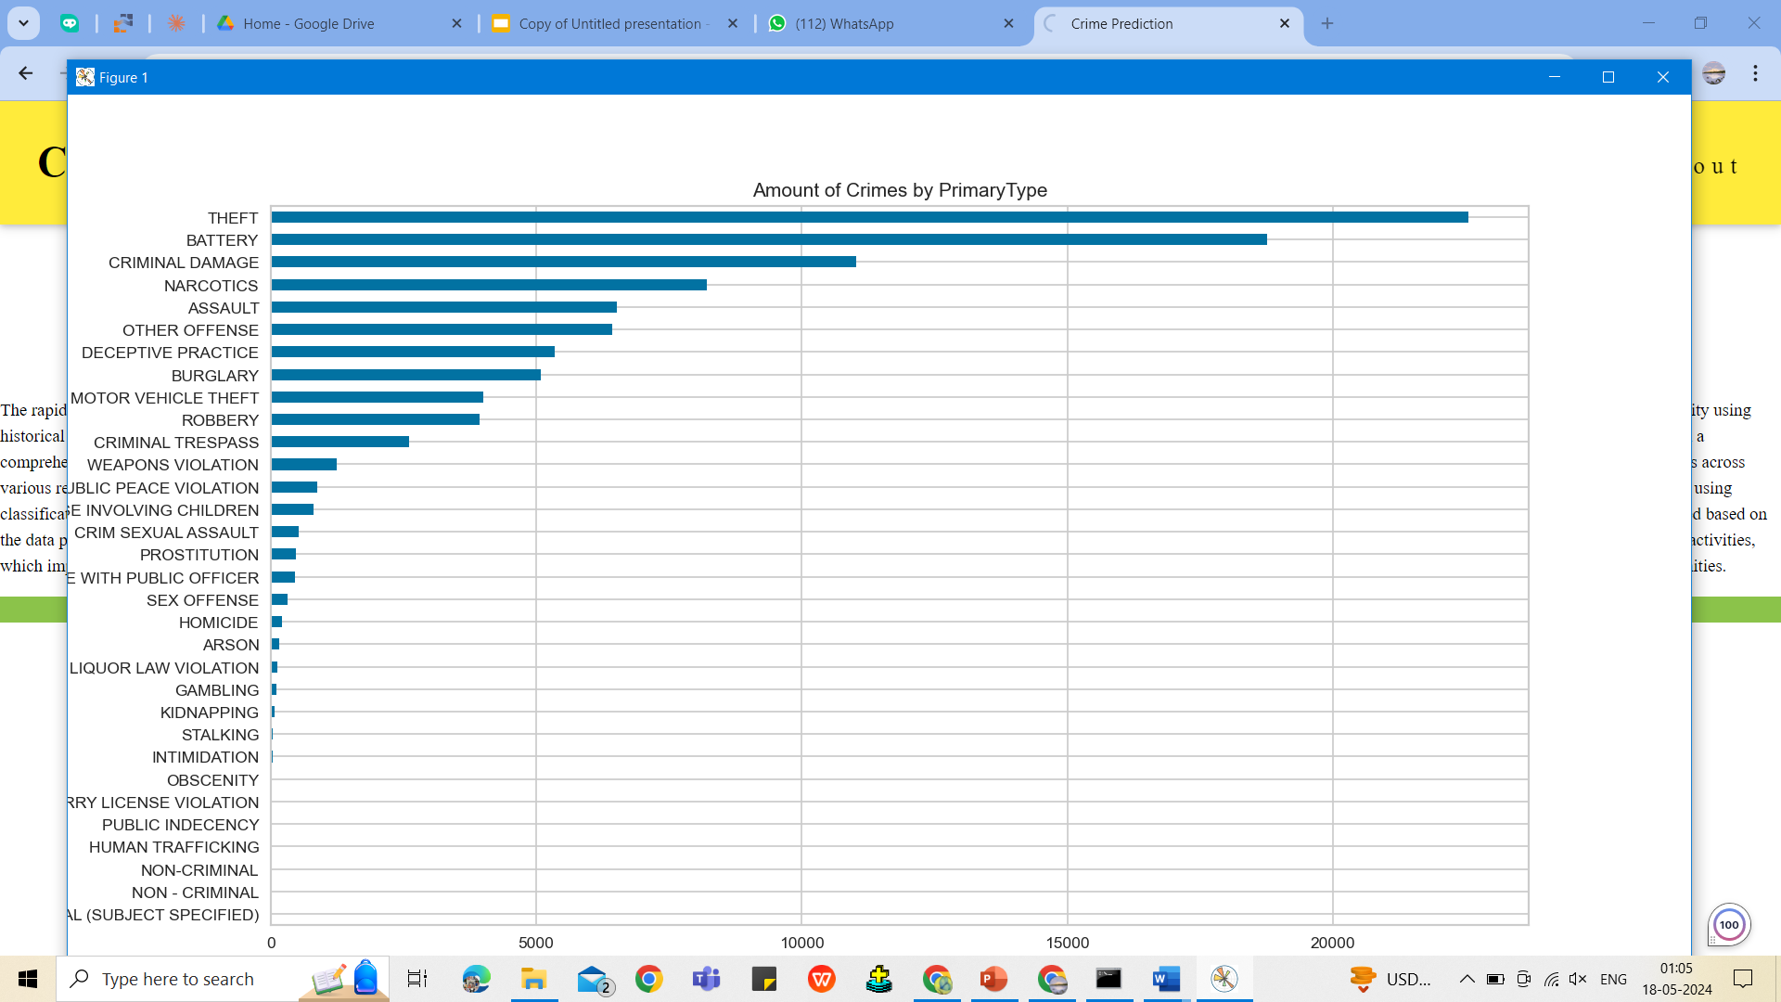
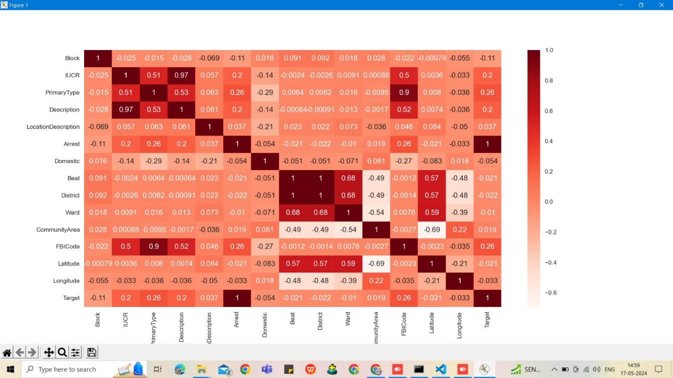
Screenshots
Training Data Training Data (Heatmap)

Slide 30
Screenshots
Admin Login Form User Login Form

Slide 31

Sample Code
USER SIDE VIEWS
# Create your views here.
from django.shortcuts import render
from django.conf import settings
from django.http import HttpResponse
from django.contrib import messages
from .forms import UserRegistrationForm
from .models import UserRegistrationModel
import pandas as pd
import numpy as np
# Create your views here.
def UserRegisterActions(request):
if request.method == 'POST':
form = UserRegistrationForm(request.POST)
if form.is_valid():
print('Data is Valid')
form.save()
messages.success(request, 'You have been successfully registered')
form = UserRegistrationForm()
return render(request, 'UserRegistrations.html', {'form': form})
else:
messages.success(request, 'Email or Mobile Already Existed')
print("Invalid form")
else:
form = UserRegistrationForm()
return render(request, 'UserRegistrations.html', {'form': form})

Slide 32
Sample Code
def UserLoginCheck(request):
if request.method =='POST':
loginid=request.POST.get('loginid')
pswd=request.POST.get('pswd')
print("Login ID = ", loginid, ' Password = ', pswd)
try:
check = UserRegistrationModel.objects.get(
loginid=loginid, password=pswd)
status = check.status
print('Status is = ', status)
if status == "activated":
request.session['id'] = check.id
request.session['loggeduser'] = check.name
request.session['loginid'] = loginid
request.session['email'] = check.email
print("User id At", check.id, status)
return render(request, 'users/userhome.html', {})
else:
messages.success(request, 'Your Account Not at activated')
return render(request, 'userlogin.html')
except Exception as e:
print('Exception is ', str(e))
pass
messages.success(request, 'Invalid Login id and password')
return render(request, 'userlogin.html', {})

Slide 33
Sample Code
def UserHome(request):
return render(request, 'users/userhome.html', {})
def viewData(request):
import pandas as pd
from django.conf import settings
import os
path=os.path.join(settings.MEDIA_ROOT,'chicago_crime_2014.csv')
df=pd.read_csv(path)
df=df.to_html
return render(request, 'users/userviewdata.html', {'data': df})
def preProcessData(request):
from .utility.PreprocessedData import preProcessed_data_view
data = preProcessed_data_view()
return render(request, 'users/preproccessed_data.html', {'data': data})
def Model_Results(request):
from .utility import PreprocessedData
nb_report = PreprocessedData.build_naive_bayes()
knn_report = PreprocessedData.build_knn()
dt_report = PreprocessedData.build_decsionTree()
rf_report = PreprocessedData.build_randomForest()
svm_report = PreprocessedData.build_svm()
mlp_report = PreprocessedData.build_mlp()
return render(request, 'users/ml_reports.html', { 'nb':nb_report,"knn":knn_report, 'dt': dt_report, 'rf': rf_report, 'svm': svm_report,'mlp':mlp_report})

Slide 34
Sample Code
def user_input_prediction(request):
if request.method=='POST':
from .utility import PreprocessedData
joninfo = request.POST.get('joninfo')
result = PreprocessedData.predict_userInput(joninfo)
print(request)
return render(request, 'users/testform.html', {'result': result})
else:
return render(request,'users/testform.html',{})
Base.html:
{% load static %}
<!DOCTYPE html>
<html>
<head>
<title>CrimePrediction</title>
<meta charset="UTF-8">
<meta name="viewport" content="width=device-width, initial-scale=1">
<link rel="stylesheet" href="https://www.w3schools.com/w3css/4/w3.css">
<style>
body {
background-image:url(../static/3.jpg);
background-repeat: no-repeat;
background-position:top;
font-family: "Times New Roman", Georgia, Serif;}

Slide 35
Sample Code
h1, h2, h3, h4, h5, h6 {
font-family: "Times New Roman";
letter-spacing: 6px;
}
</style>
</head>
<body>
<!-- Navbar (sit on top) -->
<div class="w3-top">
<div class="w3-bar w3-yellow w3-padding w3-card" style="letter-spacing:4px;">
<a href="#home" class="w3-bar-item w3-button"><h1><b>Crime Prediction</b></h1></a>
<!-- Right-sided navbar links. Hide them on small screens -->
<div class="w3-right w3-hide-small">
<ul>
<a href="{% url 'index' %}" class="w3-bar-item w3-button"><h4>Home</h4></a>
<a href="{% url 'AdminLogin' %}"class="w3-bar-item w3-button"><h4>Admin</h4></a>
<a href="{% url 'UserLogin' %}" class="w3-bar-item w3-button"><h4>User</h4> </a>
<a href="{% url 'UserRegister' %}" class="w3-bar-item w3-button"><h4>Registration</h4></a>
</ul>
</div>
</div>
</div>

Slide 36
Sample Code
<!-- Header -->
<header class="w3-display-container w3-content w3-wide" style="max-width:5000px;min-width:1500px" id="home">
<img class="w3-image" src="/w3images/hamburger.jpg" alt="Hamburger Catering" width="1600" height="600">
<div class="w3-display-bottomleft w3-padding-large w3-opacity">
<h1 class="w3-xxlarge">Le Catering</h1>
</div>
</header>
<!-- Page content -->
<div class="w3-content" style="max-width:3000px">
<!-- About Section -->
<div class="w3-row-100 w3-padding-64" id="about">
<div class="w3-col m6 w3-padding-large w3-hide-small">
</div>
</div>
</div>
<!-- Menu Section -->
{%block contents%}
{%endblock%}

Slide 37
Sample Code
<!-- Footer -->
<div>
<footer class="w3-center w3-light-green w3-padding-30">
<p>&copy; <a href="https://www.w3schools.com/w3css/default.asp" title="Ameeruddin" target="_blank" class="w3-hover-text-green">SIMRAN & RAVEENA & AFEEFA</a>
</p>
</footer>
</div>
<!-- /.javascript files -->
<script src="{%static 'js/jquery.js'%}"></script>
<script src="{%static 'js/bootstrap.min.js'%}"></script>
<script src="{%static 'js/custom.js'%}"></script>
<script src="{%static 'js/jquery.sticky.js'%}"></script>
<script src="{%static 'js/wow.min.js'%}"></script>
<script src="{%static 'js/owl.carousel.min.js'%}"></script>
<script src="{%static 'js/ekko-lightbox-min.js'%}"></script>
<script type="text/javascript">
$(document).delegate('*[data-toggle="lightbox"]', 'click', function (event) {
event.preventDefault();
$(this).ekkoLightbox();
});
</script>
<script>
new WOW().init();
</script>
</body>
</html>

Slide 38

CONCLUSION
In conclusion, the application of 2D convolutional neural networks in the field of crime prediction is promising. The framework proposed in this paper successfully addresses the many limitations of existing methods, combining a 2D-CNN with diverse data sources other than conventional crime data. The system is especially good at extracting spatial patterns from crime data defined in a 2D grid and capturing both localized crime clusters and intricate spatial relationships. Our case study demonstrates that a 2D CNN model achieves better accuracy and efficiency than traditional machine learning models and that it can be significantly improved by using various data sources and immediate prediction and prevention capabilities in real time. Ultimately, by employing 2D-CNN machine learning and other cutting-edge techniques, significant progress can be made in this regard.

Slide 39
Refernces
Adhikar, Saydul Akbar Murad, Choong Seon Hong, Md. Shirajum Munir, “ Edge Assisted Crime Prediction and Evaluation Framework for Machine Learning Algorithms”, 2022. The 36th International Conference on Information Networking (ICOIN 2022)
Fonseca, Luis, F. C. Pinto, and S. Sargento. ”An Application for Risk of Crime Prediction Using Machine Learning.” International Journal of Computer and Systems Engineering 15.2, pp. 166-174, 2021
E. Ahishakiye, D. Taremwa, E. O. Omulo, and I. Niyonzima, “Crime Prediction Using Decision Tree (J48) Classification Algorithm,” 2017. [Online]. Available: www.ijcit.com188
L. McClendon and N. Meghanathan, “Using Machine Learning Algorithms to Analyze Crime Data,” Machine Learning and Applications: An International Journal, vol. 2, no. 1, pp. 1–12, Mar. 2015.
] S. Kim, P. Joshi, P. S. Kalsi, and P. Taheri, “Crime Analysis Through Machine Learning,” in 2018 IEEE 9th Annual Information Technology, Electronics and Mobile Communication Conference, IEMCON 2018, pp. 415–420, Jan. 2019

Slide 40
Thank you

